Slide 1
OData in ASP.NET Core Web API
Notes:
https://grpc.io/

Slide 2
Objectives
OData Introduction
OData Protocol
OData Feature Areas
Data Requests
URL query conventions
Querying Data
Data Modification
Defining an Entity Data Model
Working with OData in ASP.NET Core
Demo OData Service

Slide 3
OData Introduction - 1
OData (Open Data Protocol) is an ISO/IEC approved, OASIS standard that defines a set of best practices for building and consuming REST APIs.
It enables creation of REST-based services which allow resources identified using Uniform Resource Locators (URLs) and defined in a data model, to be published and edited by Web clients using simple HTTP messages.
OData helps applications to focus on business logic without worrying about the various API approaches to define request and response headers, status codes, HTTP methods, URL conventions, media types, payload formats, query options, etc.
It provides guidance for tracking changes, defining functions/actions for reusable procedures, and sending asynchronous/batch requests.

Slide 4
OData Introduction - 2
REST is an architectural style. It provides us with a set of constraints and sub constraints, like the fact that client-server interaction should be stateless, the fact that each message must include enough information that describes how to process the message, and so on. But REST is not a standard.
OData is, essentially, a way to try and standardize REST. It's an open protocol that allows the creating and consumption of queryable and interoperable RESTful APIs in a simple and standard way. It describes things like which HTTP method to use for which type of request, which status codes to return when, but also: URL conventions.
And it also includes information on querying data - filtering and paging, but also: calling custom functions and actions, working with batch requests, and more.

Slide 5
OData
= REST
Resource-oriented: Entities modeled as URI-addressable Resources, Relationships modeled as links (URIs), CRUD = POST, GET, PUT/PATCH, DELETE
Hypermedia-driven
Navigate from Service Document to Sets to Members to related items to…
Links in Payload for editing, navigation, operations, etc.
+ Data Model
URLs, operations, namespaces, derived from declarative model
+ Common Conventions
Common query string options
Representation within Formats
+ Common Formats
ATOM, JSON

Slide 6
OData Protocol
The OData Protocol is an application-level protocol for interacting with data via RESTful interfaces.
It supports the description of data models, editing and querying of data according to those models.
REST APIs that are based on OData are easy to discover and consume due to the OData metadata, a machine-readable description of the data model which renders in a human readable format.
The OData Protocol is different from other REST-based web service approaches in that it provides a uniform way to describe both the data and the data model.
This improves semantic interoperability between systems and allows an ecosystem to emerge.

Slide 7
OData Feature Areas - 1
Versioning: API versioning can help evolving our APIs without changing or breaking the existing API services. URL segment, request header, and query string are three ways to achieve API versioning in ASP.NET Core application.
Service Metadata: OData metadata documents describe the Entity Data Model (EDM) for a given service, which is the underlying abstract data model used by OData services to formalize the description of the resources it exposes.
Data Requests: OData services support requests for data via HTTP GET requests.
Data Modification: Updatable OData services support Create, Update and Delete operation for some or all exposed entities.

Slide 8
OData Feature Areas - 2
Relationships: Relationships from one entity to another are represented as navigation properties.
Content Types: Support multiple types of content types for data responding.
Functions and Actions: OData supports custom operations (Actions and Functions).
Functions are operations exposed by an OData service that MUST return data and MUST have no observable side effects.
Actions are operations exposed by an OData service that MAY have side effects when invoked.
Functions and actions both MAY bound to an entity type, primitive type, complex type, or a collection.

Slide 9
Data Requests - Querying Data
Querying a Set
GET /v2/Catalog/Genres HTTP/1.1
Requesting an Individual Entity by ID
GET /v2/Catalog/Genres('Adventures') HTTP/1.1
Requesting an Individual Property
GET /v2/Catalog/Genres('Adventures')/Name HTTP/1.1
Requesting an Individual Property Raw Value
GET /v2/Catalog/Genres('Adventures')/Name/$value HTTP/1.1

Slide 10
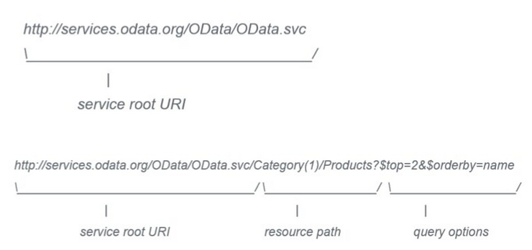
Data Requests - Querying Data
URL query conventions
Notes:
https://docs.oasis-open.org/odata/odata/v4.01/odata-v4.01-part2-url-conventions.html

Slide 11
Data Requests - Querying Data
$filter
Basic predicates, built-in functions
$sort
Properties, expressions
$select
Narrow the set of fields returned
$top/$skip
Client-side paging
$expand
Include related entities
$count/$inlinecount
Include count of entities
Server Driven Paging

Slide 12
Data Requests - $Filter
Basic predicates, built-in functions
GET /v2/Catalog/Titles?$filter=Name eq 'The Sting' HTTP/1.1
Filter on Properties of a derived type
Only returns entities of that type that match the predicate
GET /v2/Catalog/Awards?$filter=Netflix.AcademyAward/Category HTTP/1.1
Query based on collection Membership using Any/All
GET /v2/Catalog/Titles?$filter=Genres/Any(g:g/Name eq 'Adventure') HTTP/1.1

Slide 13
Data Requests - Operators
Logical Operators
eq, ne, gt, ge, lt, le, and, or, not
Mathematic Operators
add, sub, mult, div, mod
Grouping Operator
()
NULL literal
null

Slide 14
Data Requests - Built-in Functions
String Functions
substringof, endswith, startswith, length, indexof, substring, tolower, toupper, trim, concat
DateTime Functions
year(), month(), day(), hour(), minute(), second()
Math Functions
round(), floor(), ceiling()
Type Functions
isof()
Casting
Insert type in path
Geo Functions
geo.length, geo.intersects, geo.distance

Slide 15
Data Requests - $Orderby
Comma separated list of properties, expressions
GET /v2/Catalog/Titles?$orderby=AverageRating,ReleaseYear HTTP/1.1
Can specify asc (default) or desc
GET /v2/Catalog/Titles?$orderby=AverageRating desc HTTP/1.1

Slide 16
Data Requests - $top/$skip
Enables Client-side paging through large result sets
GET /v2/Catalog/Titles?$top=10&$orderby=AverageRating desc HTTP/1.1
GET /v2/Catalog/Titles?$top=10&$skip=10 &$orderby=AverageRating desc HTTP/1.1
If no $orderby, server guarantees stable ordering

Slide 17
Data Requests - $expand
Specify comma separated list of navigation property paths to include in response
GET /v2/Catalog/Titles?$expand=Cast,Awards HTTP/1.1
Result are returned inline according to the appropriate format

Slide 18
Data Requests - $select
Narrow the set of fields returned
GET /v2/Catalog/Titles?$select=Name,Synopsis,Rating HTTP/1.1
Related properties must be specified in $expand
GET /v2/Catalog/Titles?$select=Name,Cast/Name&$expand=Cast HTTP/1.1
Can include all properties using *
Does not include navigation properties
GET /v2/Catalog/Titles?$select=* HTTP/1.1

Slide 19
Data Requests - $count/$inlinecount
Get just the count
Can include additional query operators
GET /v2/Catalog/Titles/$count HTTP/1.1
Include the count with the results
$inlinecount ignores $top/$skip but includes $filter
GET /v2/Catalog/Titles?$inlinecount=allpages&$top=10 HTTP/1.1

Slide 20
Data Requests - $FORMAT
Specify a particular format
"atom"
application/atom+xml,
application/atomsvc+xml for service document
"json"
application/json
"xml"
application/xml
Overrides content type specified in headers

Slide 21
Data Requests - Server Driven Paging
Server controls the maximum number of records to return at a time
Each "page" of results includes a "next link" for retrieving the next page of results
Pages can vary in size; some may be blank
i.e., return records as computed or across a federation

Slide 22
Data Modification - Insert
POST entity to the EntitySet collection
Returns inserted entity
Use PREFER header to request no content returned
Media Resources have special rules according to AtomPub:
POST media resource to the collection
Returns Media Link Entry
Update the Media Link Entry

Slide 23
Data Modification - Update
PUT to the edit-link to replace
Unspecified values are set to null or default
PATCH to the edit-link to affect only specified values
Unspecified values are left unchanged
Use PREFER header to request content returned
Use entity etag in if-match for concurrency control
Obtained from header or payload

Slide 24
Data Modification - Delete
DELETE to the edit-link to delete
Use entity etag in if-match for concurrency control
Obtained from header or payload

Slide 25
Data Modification - Batch Requests
"Batch" multiple statements in a single multi-part mime request
Results for each statement returned in a multi-part mime response
Multiple Data Modification statements may be grouped in a single "ChangeSet"
ChangeSets are atomic
Reference the results of other statements in the changeset. i.e., add a child to an added parent
May have multiple ChangeSets per Batch

Slide 26
Relationships - 1
Requesting Relationship Links
Use $links to request the relationship links for a particular navigation property
Results are returned as an array of URIs - GET /v2/Catalog/Titles/Genres('Adventures')/$links/Titles HTTP/1.1
Creating Links to New Entities
Create a new Entity with a new related entity by POSTing the entity with the related entity as inline content ("Deep Inserts")
Create a new entity related to an existing entity by POSTing to the relationship collection of the existing entity - POST /v2/Catalog/Titles/Genres('Adventures')/$links/Titles HTTP/1.1<entry>…</entry>

Slide 27
Relationships - 2
Creating Links to Existing Entities
Create a relationship between two existing entities by POSTing the URL of the one entity to the appropriate $links collection of the other entity
POST /v2/Catalog/Titles/Genres('Adventures')/$links/Titles HTTP/1.1
<uri>http://odata.netflix.com/v2/Catalog/Titles('13kbf')</uri>

Slide 28
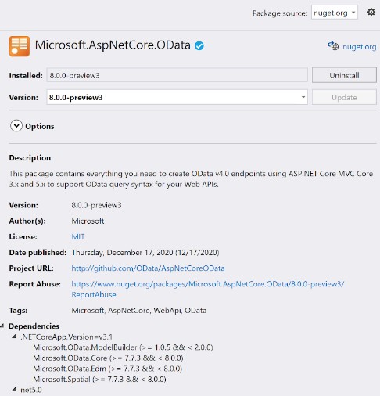
Working with OData in ASP.NET Core
Prerequisites for working with OData - Adding the NuGet Packages. The package named Microsoft.AspNetCore.OData.
This package is supported for .NET Core and for .NET 5. Version 7.x of the package is for .NET Core, version 8.x is for .NET 5.

Slide 29
Defining an Entity Data Model
The Entity Data Model, or EDM, is the abstract data model that is used to describe the data exposed by an OData service. This is the "heart" of your OData services.
If you've worked with Entity Framework Core, this concept will sound familiar - the EDM is not at all exclusive to OData, EF Core works on something likewise. It was introduced as a set of concepts that describe the structure of data, regardless of its stored form.
The EDM makes the stored form of data irrelevant to application design and development. Because entities and relationships describe the structure of data as it is used in an application (not its stored form), they can evolve as an application evolves.

Slide 30
OData in ASP.NET Core Web API Demo 1

Slide 31
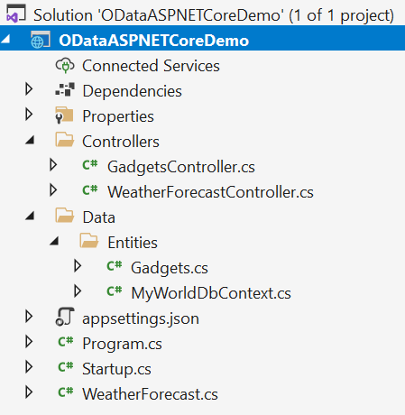
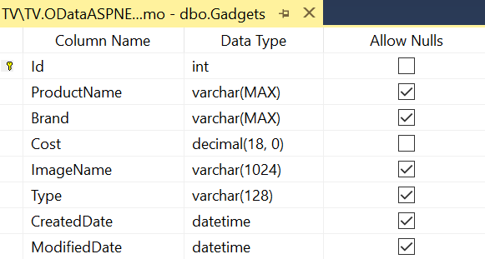
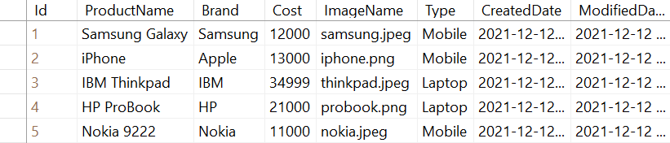
Demo 1 - OData Simple Query
Demo OData query features
$select
$orderBy
$filter
$skip
$count
$expand

Slide 32
Setup and Install NuGet packages
Install-Package Microsoft.EntityFrameworkCore -Version 5.0.12
Install-Package Microsoft.EntityFrameworkCore.SqlServer -Version 5.0.12
Install-Package Microsoft.AspNetCore.OData -Version 8.0.0
Or using dotnet command line
dotnet add package Microsoft.EntityFrameworkCore --version 5.0.12
dotnet add package Microsoft.EntityFrameworkCore.SqlServer --version 5.0.12
dotnet add package Microsoft.AspNetCore.OData --version 8.0.0

Slide 33
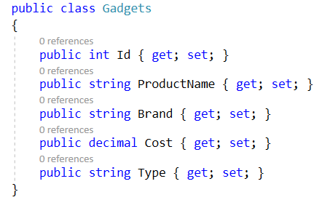
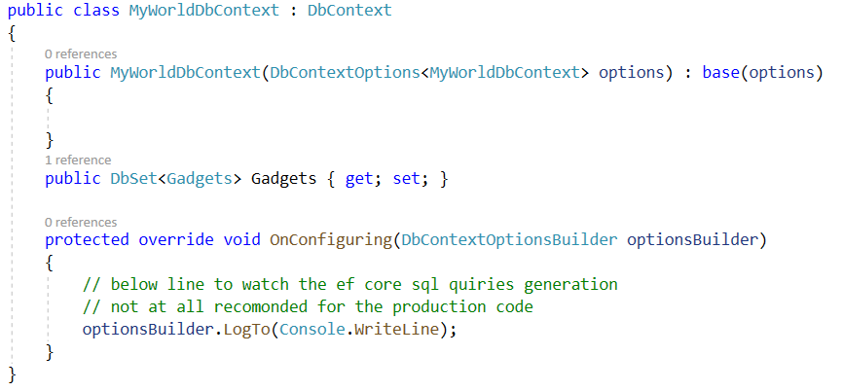
Setup EntityFramework Core DbContext
Add database connection string into 'appsettings.json'.

Slide 34
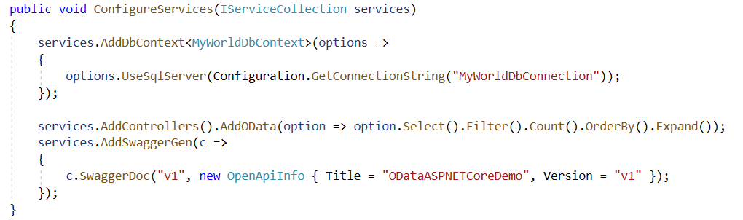
Configure OData Service
Extend the 'AddControllers()' service to register our OData service.
Register our OData query types Select(), Filter(), Count(), OrderBy(), Expand()

Slide 35
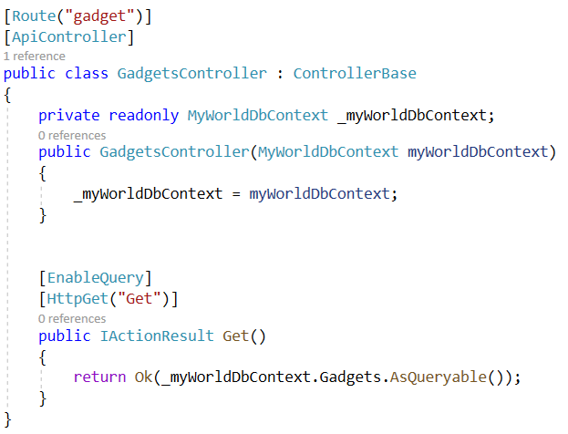
Create API Action Method Returns Queryable Results

Slide 36
Run OData Service - 1
$select: The $select system query option allows clients to request a specific set of properties for each entity or complex type. The set of properties will be comma-separated while requesting.
https://localhost:5001/gadget/Get?$select=ProductName,Cost
$filter: The $filter filters data based on a boolean condition. The following are conditional operators that have to be used in URLs.
https://localhost:5001/gadget/Get?$filter=ProductName eq ‘Samsung Galaxy‘

Slide 37
Run OData Service - 2
$orderby: The $orderby sorts the data using 'asc' and 'desc' keywords. We can do sorting on multiple properties using comma separation.
https://localhost:5001/gadget/Get?$orderby=Id desc
$top: The $top fetches specified the count of top records in the collection. So to work this operator, we must specify an extension method like 'SetMaxTo(specify_max_number)'.
https://localhost:5001/gadget/Get?$top=2
$skip: The $skip skips the specified number of records and fetches the remaining data. https://localhost:5001/gadget/Get?$skip=5

Slide 38
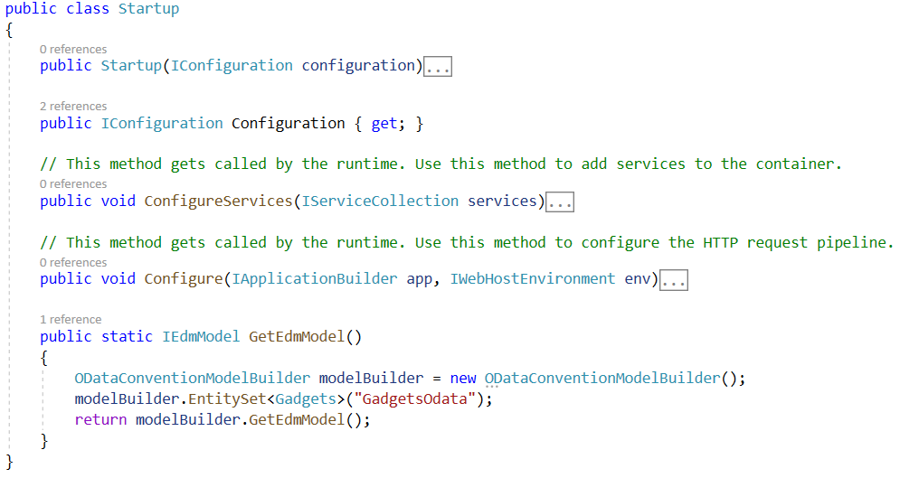
Run OData Service - 3
$count: To make $count work we will implement Odata routing.

Slide 39
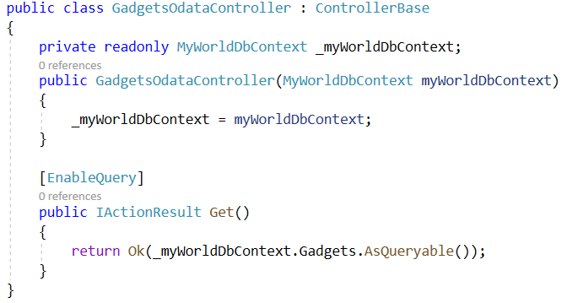
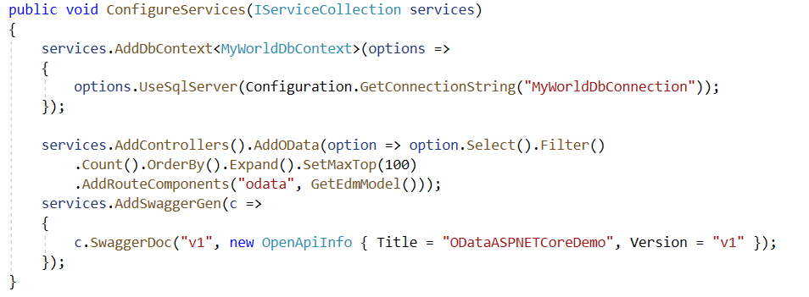
Run OData Service - 4

Slide 40
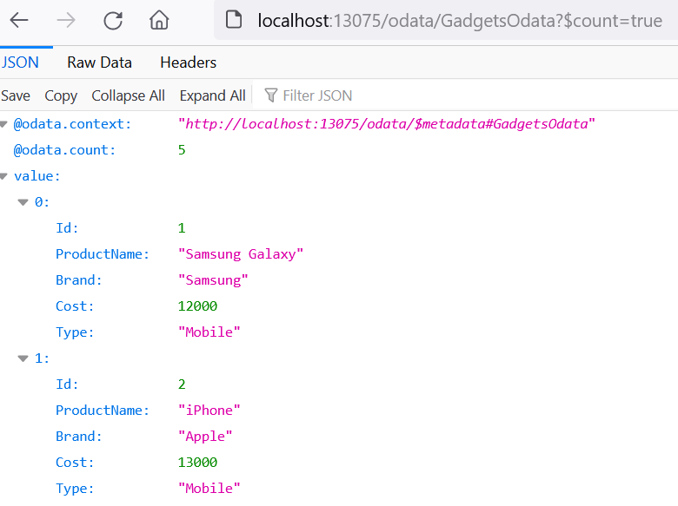
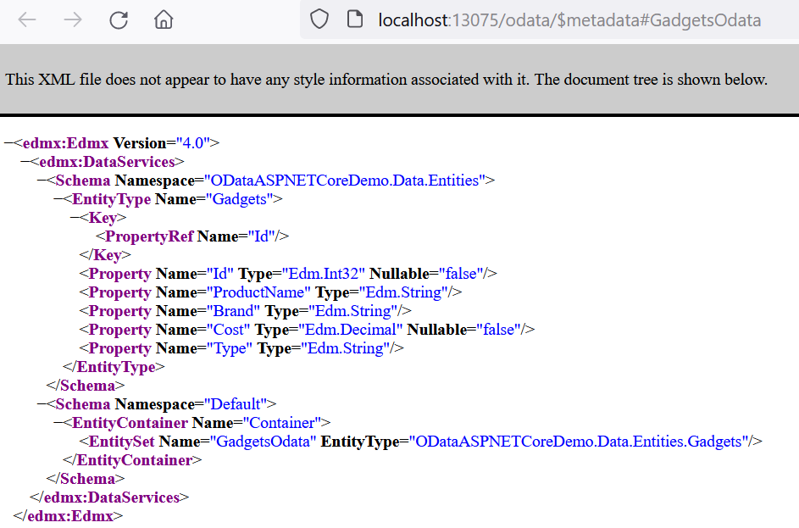
Run OData Service - 5
http://localhost:13075/odata/GadgetsOdata?$count=true

Slide 41
OData in ASP.NET Core Web API Demo 2

Slide 42
Demo 2 - Creating an OData Service
Create the Application
Build the Entity Data Model
Create the Data Source
Create Data Context
Add Data
Add Controllers
Register Services
Test: Query Metadata

Slide 43
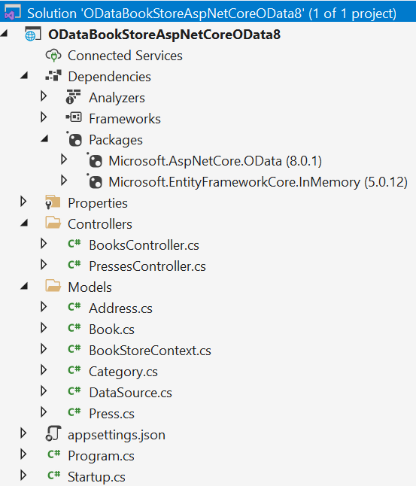
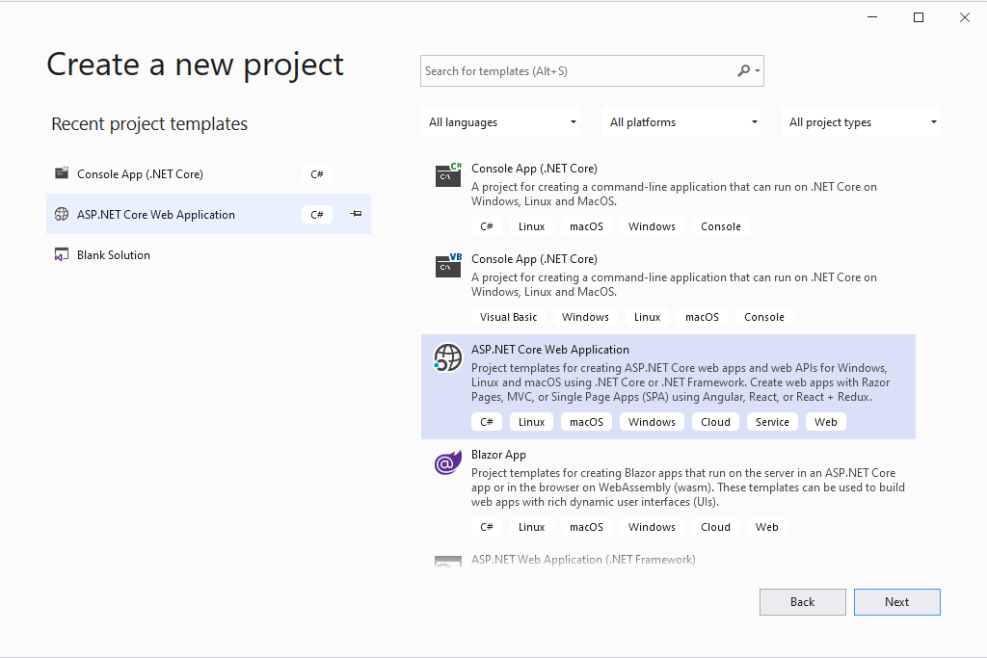
Create the Application
ASP.NET Core Web API project with packages:
Microsoft.AspNetCore.Odata (8.0.1)
Microsoft.EntityFrameworkCore.InMemory

Slide 44
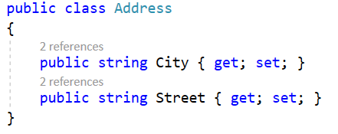
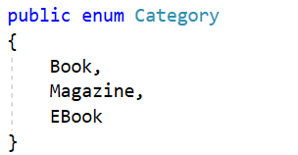
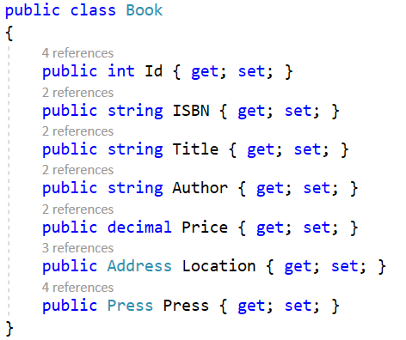
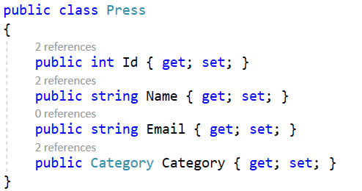
Build the Entity Data Model - 1
Model classes

Slide 45
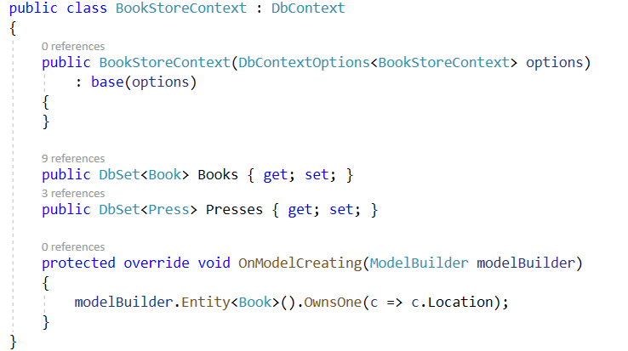
Build the Entity Data Model - 2
Create the Database Context extends DbContext class

Slide 46
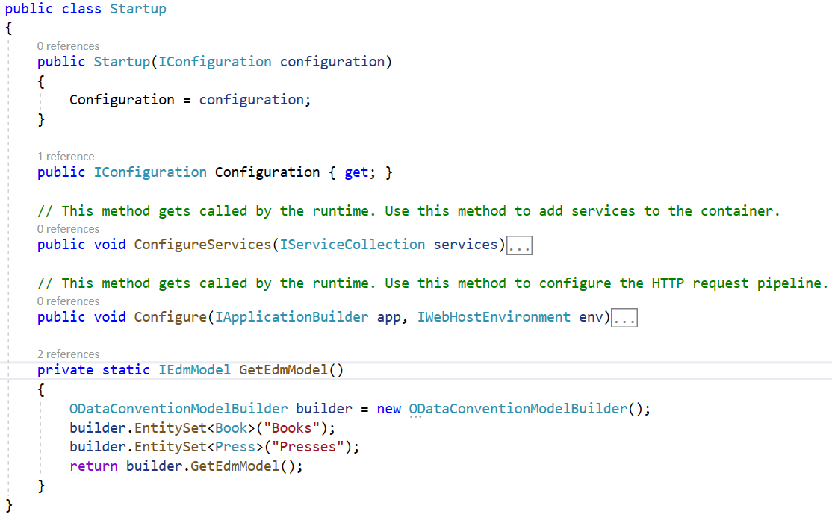
Build the Entity Data Model - 3
OData uses the Entity Data Model (EDM) to describe the structure of data.
In ASP.NET Core OData, it’s easy to build the EDM based on the above CLR types (Entity, Complex, Enum).

Slide 47
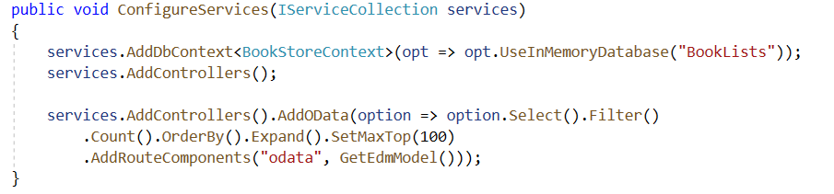
Register the OData Services
Register Services through Dependency Injection
ASP.NET Core OData requires some services registered ahead to provide its functionality. The library provides an extension method AddOData() to register the required OData services through the built-in dependency injection.

Slide 48
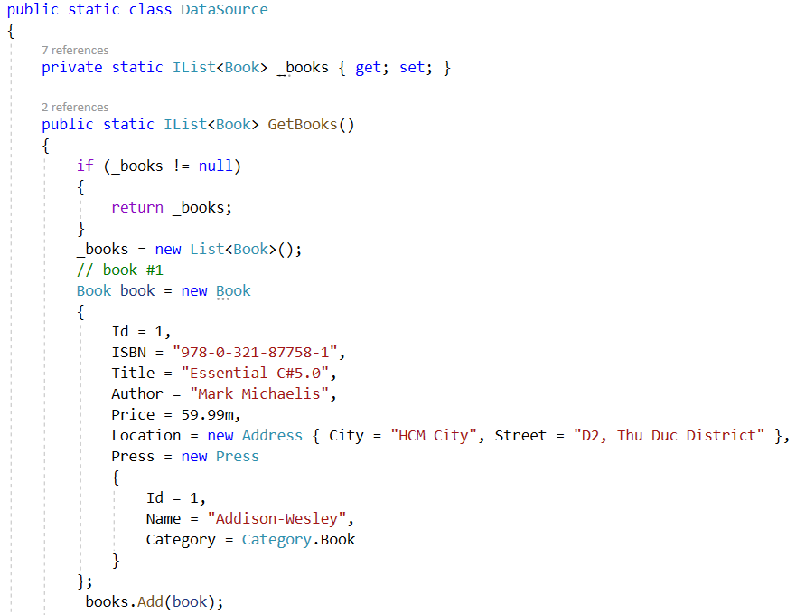
Inline Model Data
Build a class to contain the inline model data

Slide 49
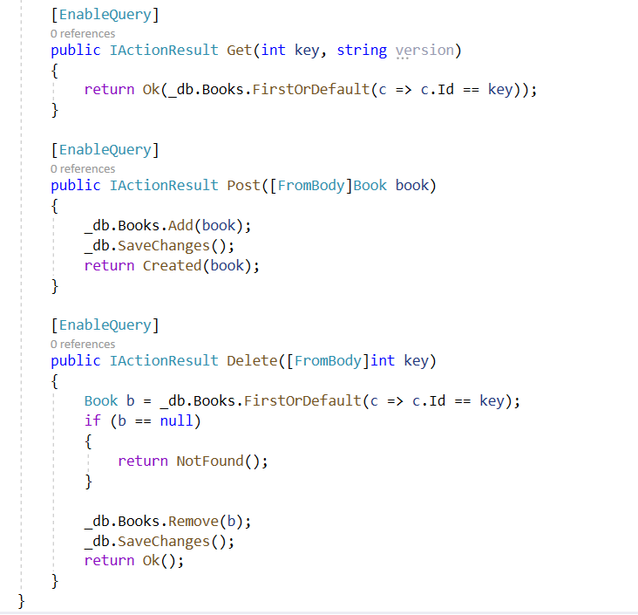
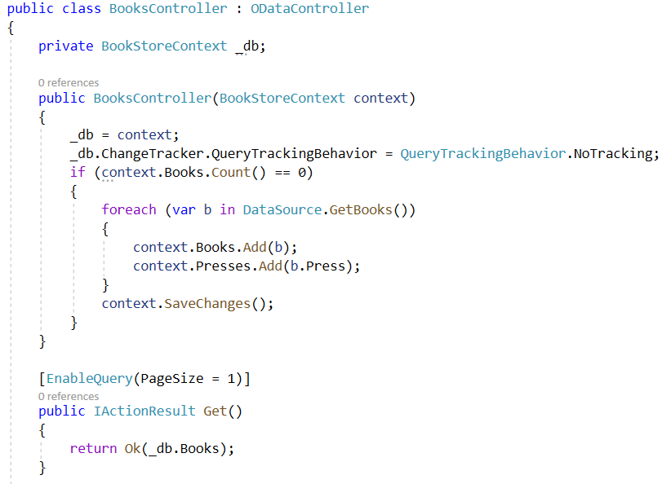
Build the Controller - 1
BooksController

Slide 50
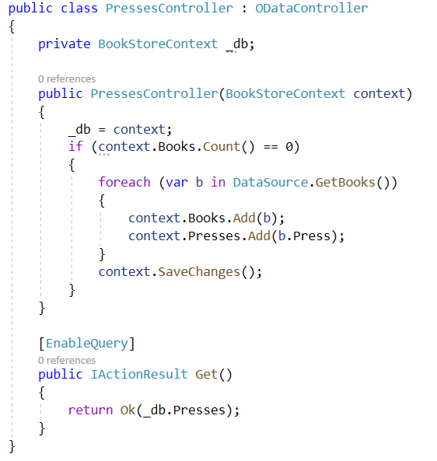
Build the Controller - 2
PressesController using namespaces
Microsoft.AspNetCore.Mvc
Microsoft.AspNetCore.OData.Query;
Microsoft.AspNetCore.OData.Routing.Controllers;

Slide 51
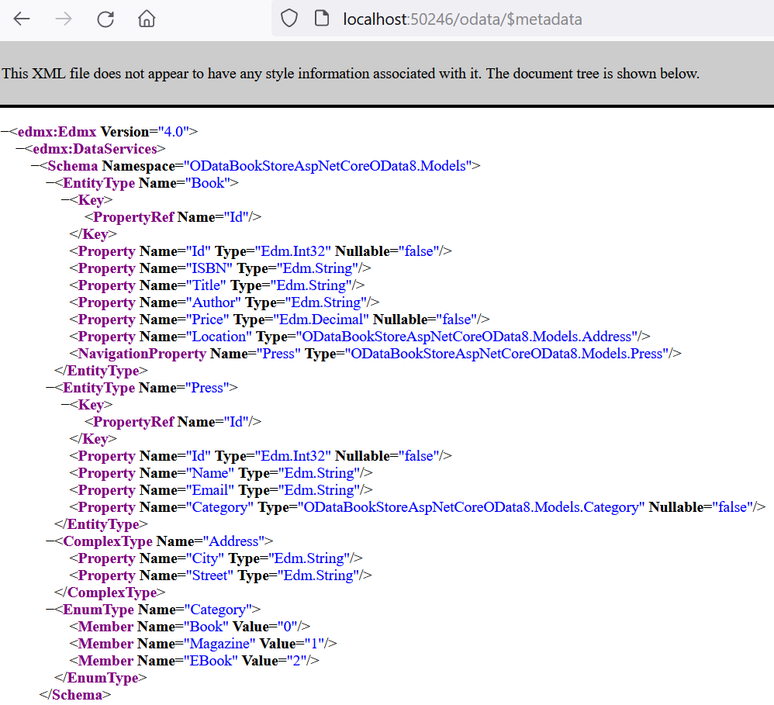
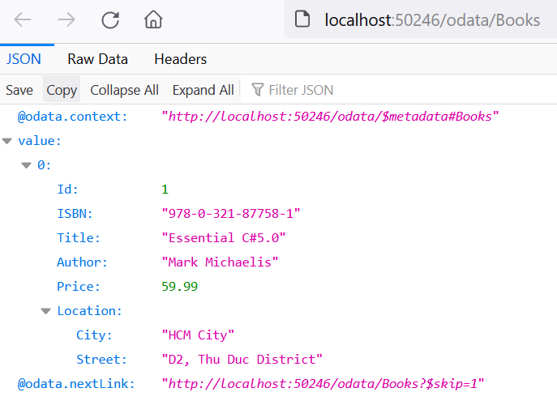
Query the metadata
http://localhost:50246/odata/$metadata

Slide 52
Summary
Concepts were introduced:
OData Introduction
OData Protocol
OData Feature Areas
Data Requests
URL query conventions: Querying Data, Data Modification
Defining an Entity Data Model
Working with OData in ASP.NET Core
Demo OData Service

